Slide 1
Developing websites with Django and Python
Susan Ibach | Senior Technical Evangelist
Christopher Harrison | Senior Content Developer

Slide 2
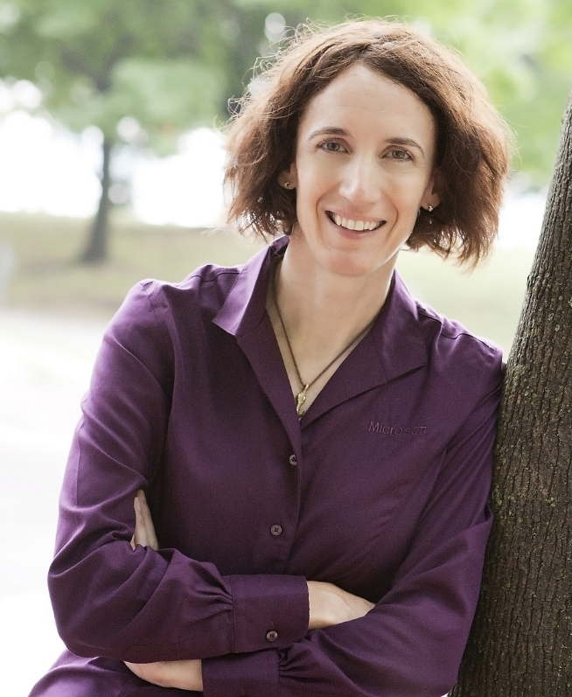
Meet Susan Ibach| ‏@hockeygeekgirl
Senior Technical Evangelist
Helping developers understand Visual Studio, app building
Microsoft Certified Trainer
My first program was written in basic on a computer with 64K of memory
Will not admit how many years coding experience
Basic, Fortran, COBOL, VB, C#, HTML, Python
Frequent blogger and presenter
marathoner, wife, and mother of two awesome boys!

Slide 3
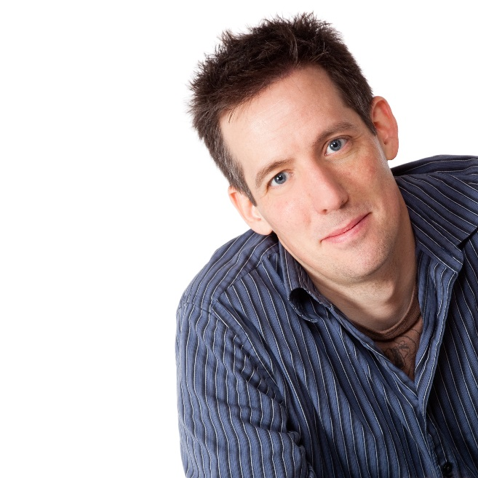
Meet Christopher Harrison | ‏@geektrainer
Content Developer
Focused on web development
Microsoft Certified Trainer
Still misses his Commodore 64
Long time geek
Regular presenter at TechEd
Periodic blogger
Certification advocate
Marathoner, husband, father of one four legged child

Slide 4
Course Topics
Developing websites with Django and Python
01 | Introduction to Django | 04 | URLs and routing
02 | Building models and databases | 05 | Layouts and forms
03 | Querying models | 06 | Deployment and next steps

Slide 5
Setting Expectations
Target Audience
Python developers learning web development
Web developers familiar with other platforms
Suggested Prerequisites/Supporting Material
Some Python experience
MVC experience
Flask experience
Introduction to Programming with Python MVA

Slide 6
Join the MVA Community!
Microsoft Virtual Academy
Free online learning tailored for IT Pros and Developers
Over 1M registered users
Up-to-date, relevant training on variety of Microsoft products
“Earn while you learn!”
Get 50 MVA Points for this event!
Visit http://aka.ms/MVA-Voucher
Enter this code: PythonDjango (expires July 20, 2015)

Slide 7
01 | Introduction to Django
Susan Ibach | Technical Evangelist
Christopher Harrison | Content Developer

Slide 8
Module Overview
What is Django?
Moving parts
Hello, Django

Slide 9
What is Django?

Slide 10
Django makes it easier to build better Web apps more quickly and with less code. The web framework for perfectionists with deadlines
https://www.djangoproject.com/

Slide 11
Designed to be fast for developers
Many features you want are already built in
Templating and layouts
Object relational mapper (ORM)
Site administration
Security
Easy to understand
Very powerful

Slide 12
Moving parts

Slide 13
Introducing Model, View, Controller (MVC)
MVC is a pattern
Three basic parts
Model, which is your data
View, which is what the user will see
Controller, which takes the user request and gets the job done

Slide 14
What's a pattern?
A pattern is a recipe to be used to solve a problem
Recipes do not need to be followed exactly
Substitutions are made based on allergies, ingredients on hand, personal preferences, etc.
Use what fits, and modify where it doesn't

Slide 15
Models, Views, and Controllers
What does MVC look like?
Request
Controller
Controller
Retrieves Model
“Does Stuff”

user

Model
Response
View
View
Visually represents
the model

Notes:
20486A
01: Exploring ASP.NET MVC 4

Slide 16
Django flow
Request
URL config
Routing
Figures out what the user wants
Calls the right View

user

Response
View
View
Loads the data
Calls the template

View
Template

Slide 17
Hello, Django

